Slide 1
UNIT – 3 Advanced Node JS and Database
PRESENTED BY PROF.HIMANI KHODIFAD

Slide 2
Advanced Node JS and Database
Advanced Node.js involves mastering its unique architecture and integrating effectively with various databases to build scalable, high-performance applications. Key areas of focus include:

Slide 3
Introduction to NoSQL databases

Slide 4
What is NoSQL?
NoSQL Database is a non-relational Data Management System, that does not require a fixed schema. It avoids joins, and is easy to scale. The major purpose of using a NoSQL database is for distributed data stores with humongous data storage needs. NoSQL is used for Big data and real-time web apps. For example, companies like Twitter, Facebook and Google collect terabytes of user data every single day.
NoSQL database stands for “Not Only SQL” or “Not SQL.” Though a better term would be “NoREL”, NoSQL caught on. Carl Strozz introduced the NoSQL concept in 1998.
Traditional RDBMS uses SQL syntax to store and retrieve data for further insights. Instead, a NoSQL database system encompasses a wide range of database technologies that can store structured, semi-structured, unstructured and polymorphic data.

Slide 5
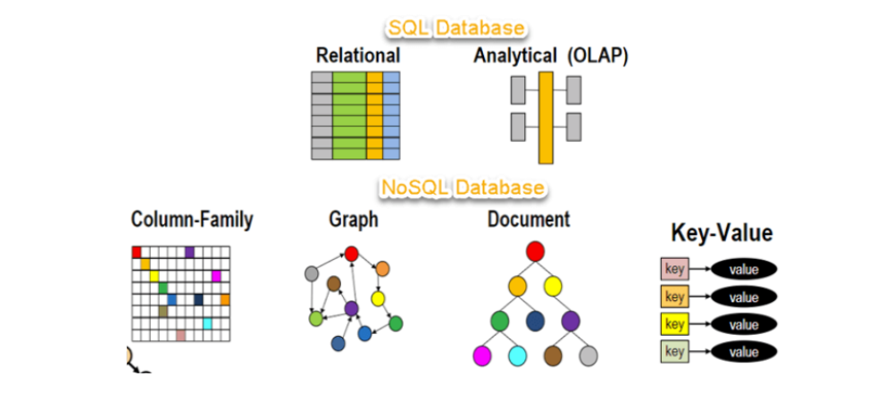
Let’s understand about NoSQL with a diagram in this NoSQL database tutorial:

Slide 6
Why NoSQL?
The concept of NoSQL databases became popular with Internet giants like Google, Facebook, Amazon, etc. who deal with huge volumes of data. The system response time becomes slow when you use RDBMS for massive volumes of data To resolve this problem, we could “scale up” our systems by upgrading our existing hardware. This process is expensive.

Slide 7
Brief History of NoSQL Databases
1998- Carlo Strozzi use the term NoSQL for his lightweight, open-source relational
database
2000- Graph database Neo4j is launched
2004- Google BigTable is launched
2005- CouchDB is launched
2007- The research paper on Amazon Dynamo is released
2008- Facebooks open sources the Cassandra project
2009- The term NoSQL was reintroduced

Slide 8
Features of NoSQL
Non-relational
NoSQL databases never follow the relational model
Never provide tables with flat fixed-column records
Work with self-contained aggregates or BLOBs
Doesn’t require object-relational mapping and data normalization
No complex features like query languages, query planners,referential integrity joins, ACID
Schema-free
NoSQL databases are either schema-free or have relaxed schemas
Do not require any sort of definition of the schema of the data
Offers heterogeneous structures of data in the same domain

Slide 9
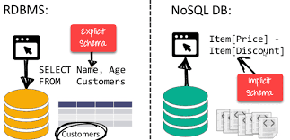

Slide 10
Simple API
Offers easy to use interfaces for storage and querying data provided
APIs allow low-level data manipulation & selection methods
Text-based protocols mostly used with HTTP REST with JSON
Mostly used no standard based NoSQL query language
Web-enabled databases running as internet-facing services
Distributed
Multiple NoSQL databases can be executed in a distributed fashion
Offers auto-scaling and fail-over capabilities
Often ACID concept can be sacrificed for scalability and throughput
Mostly no synchronous replication between distributed nodes Asynchronous Multi-
Master Replication, peer-to-peer, HDFS Replication
Only providing eventual consistency
Shared Nothing Architecture. This enables less coordination and higher distribution.

Slide 11
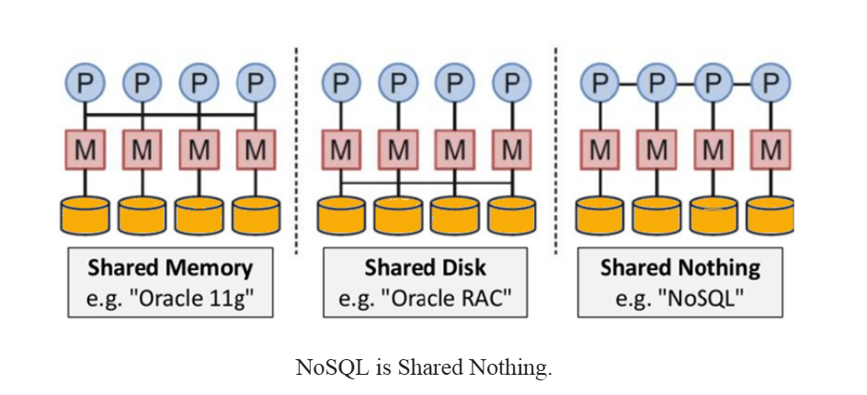

Slide 12
MongoDB system overview

Slide 13
What is MongoDB?
MongoDB is a document-oriented NoSQL database used for high volume data storage. Instead of using tables and rows as in the traditional relational databases, MongoDB makes use of collections and documents. Documents consist of key-value pairs which are the basic unit of data in MongoDB. Collections contain sets of documents and function which is the equivalent of relational database tables. MongoDB is a database which came into light around the mid-2000s.

Slide 14
MongoDB Features
Each database contains collections which in turn contains documents. Each document can be different with a varying number of fields. The size and content of each document can be different from each other.
The document structure is more in line with how developers construct their classes and objects in their respective programming languages. Developers will often say that their classes are not rows and columns but have a clear structure with key-value pairs.
The rows (or documents as called in MongoDB) doesn’t need to have a schema defined beforehand. Instead, the fields can be created on the fly.
The data model available within MongoDB allows you to represent hierarchical relationships, to store arrays, and other more complex structures more easily.
Scalability – The MongoDB environments are very scalable. Companies across the world have defined clusters with some of them running 100+ nodes with around millions of documents within the database

Slide 15
Key Components of MongoDB Architecture
Below are a few of the common terms used in MongoDB
_id –
This is a field required in every MongoDB document. The _id field represents a unique value in the MongoDB document. The _id field is like the document’s primary key. If you create a new document without an _id field, MongoDB will automatically create the field. So for example, if we see the example of the above customer table, Mongo DB will add a 24 digit unique identifier to each document in the collection
_Id | CustomerID | CustomerName | OrderID
563479cc8a8a4246bd27d784 | 11 | Guru99 | 111
563479cc7a8a4246bd47d784 | 22 | Trevor Smith | 222
563479cc9a8a4246bd57d784 | 33 | Nicole | 333

Slide 16
2. Collection – This is a grouping of MongoDB documents. A collection is the equivalent of a table which is created in any other RDMS such as Oracle or MS SQL. A collection exists within a single database. As seen from the introduction collections don’t enforce any sort of structure.
3. Cursor – This is a pointer to the result set of a query. Clients can iterate through a cursor to retrieve results.
4. Database – This is a container for collections like in RDMS wherein it is a container for tables. Each database gets its own set of files on the file system. A MongoDB server can store multiple databases.
5. Document – A record in a MongoDB collection is basically called a document. The document, in turn, will consist of field name and values.
6. Field – A name-value pair in a document. A document has zero or more fields. Fields are analogous to columns in relational databases.The following diagram shows an example of Fields with Key value pairs. So in the example below CustomerID and 11 is one of the key value pair’s defined in the document.

Slide 17
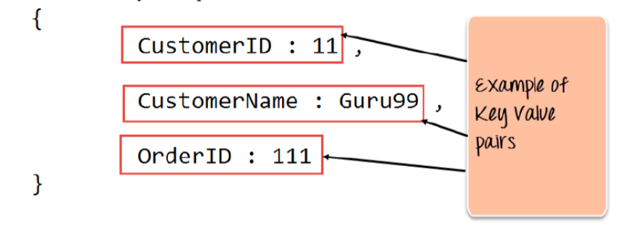
7. JSON – This is known as JavaScript Object Notation. This is a human-readable, plain text format for expressing structured data. JSON is currently supported in many programming languages.

Slide 18
Basic querying with MongoDB shell

Slide 19
Basic Querying in MongoDB Shell (mongosh)
Basic querying in MongoDB Shell (mongosh) primarily uses the db.collection.find() method, which allows you to retrieve documents from a collection.
Essential Setup Commands
Connect to MongoDB
Open your terminal and run:
Mongosh
This connects to the local MongoDB instance.
View All Databases
show dbs
Displays a list of all databases available in MongoDB.
Switch to a Database
use <database_name>
Example: use myDatabase
Note: A database is created automatically when data is first inserted.

Slide 20
View Collections in Current Database
show collections
Lists all collections inside the current database.
2. Basic Query Operations
The main methods used for querying documents are:
find()
findOne()
Both methods accept a query filter document as their first parameter.
Select All Documents
db.collection.find({})
or simply
db.collection.find()
The shell automatically iterates and displays the first 20 results.

Slide 21
Select a Single Document
db.collection.findOne({})
Returns the first document found in the collection.
Specify an Equality Condition
db.collection.find({ field: "value" })
Example: db.students.find({ name: "John" })
Returns all documents where field equals the specified value.
Multiple Conditions (Logical AND)
db.collection.find({ field1: "value1", field2: "value2" })
Example: db.students.find({ name: "John", age: 20 })
MongoDB automatically applies a logical AND when multiple conditions are included.

Slide 22
3. Advanced Querying with Operators
MongoDB uses query operators (starting with $) for complex queries.
Comparison Operators
Example: Find documents where age is greater than or equal to 25
db.collection.find({ age: { $gte: 25 } })
Common comparison operators:
Operator | Meaning
$gt | Greater than
$gte | Greater than or equal
$lt | Less than
$lte | Less than or equal
$ne | Not equal

Slide 23
Logical Operators
Example: Find documents where status = "A" OR age < 30
db.collection.find({
$or: [
{ status: "A" },
{ age: { $lt: 30 } }
]
})
Array Operators
Find documents where an array contains a value
db.collection.find({ tags: "mongodb" })
Find documents where array contains any of the specified values
db.collection.find({
tags: { $in: ["mongodb", "database"] }
})
4. Projection (Selecting Specific Fields)
Projection allows you to choose which fields to return.
Syntax:
db.collection.find(query, projection)

Slide 24
Example:
db.collection.find(
{},
{ title: 1, author: 1, _id: 0 }
)
Explanation:
This example returns only title and author, excluding _id.
Value | Meaning
1 | Include field
0 | Exclude field

Slide 25
5. Query Modifiers
Modifiers help refine query results.
Limit the Number of Results
db.collection.find().limit(5)
Returns only 5 documents.
Sort the Results
Ascending Order
db.collection.find().sort({ age: 1 })
Descending Order
db.collection.find().sort({ age: -1 })
Value | Meaning
1 | Ascending
-1 | Descending

Slide 26
Request body parsing in Express

Slide 27
Introduction
Request body parsing in Express.js refers to the process of reading and converting the data sent in the HTTP request body into a usable JavaScript object. The parsed data becomes available in the req.body property.
This is done using middleware functions that process the request before it reaches the route handler.

Slide 28
Built-in Body Parsing Middleware
From Express v4.16.0 and later, built-in middleware is available for parsing common request body formats, so installing body-parser separately is usually unnecessary.
The two main built-in parsers are:
Middleware | Purpose
express.json() | Parses JSON request bodies
express.urlencoded() | Parses URL-encoded form data

Slide 29
1. Parsing JSON Request Body
Used when the request header contains:
Content-Type: application/json
Example:
const express = require('express');
const app = express();
// Middleware to parse JSON data
app.use(express.json());
app.post('/data', (req, res) => {
console.log(req.body); // Parsed JSON data
res.send("JSON data received");
});
app.listen(3000);
Here, the JSON data sent by the client becomes available in req.body.

Slide 30
2. Parsing URL-Encoded Form Data
Used for HTML form submissions with header:
Content-Type: application/x-www-form-urlencoded
Example:
const express = require('express');
const app = express();
// Middleware to parse form data
app.use(express.urlencoded({ extended: true }));
app.post('/form', (req, res) => {
console.log(req.body); // Parsed form fields
res.send("Form data received");
});
app.listen(3000);
extended Option
Value | Meaning
true | Supports nested objects and arrays
false | Supports only simple key-value pairs

Slide 31
Important Points
Middleware Order Body parsing middleware must be placed before route handlers. app.use(express.json()); app.post('/user', (req, res) => { console.log(req.body); }); | 2. req.body is Undefined Without Middleware If body parsing middleware is not used: req.body → undefined
3. Content-Type Header The client must send the correct header so Express knows how to parse the request body. Examples: application/json application/x-www-form-urlencoded | 4. File Uploads Built-in middleware does not support file uploads (multipart/form-data). For this, use modules like Multer(Multer is a middleware for Node.js designed to handle multipart/form-data, the encoding type used for file uploads in web forms. Commonly used with Express.js, it simplifies processing user-uploaded files by adding file and form data to the request object. Written on top of the busboy parser, it emphasizes performance and flexibility.).

Slide 32
NodeJS MongoDB connection

Slide 33
1. Introduction
Node.js is a JavaScript runtime used to build server-side applications.
MongoDB is a NoSQL database that stores data in JSON-like documents.
To store and retrieve data from MongoDB using Node.js, we must establish a connection between the Node.js application and the MongoDB database using the MongoDB Node.js driver or Mongoose library.
The connection allows the Node.js application to perform database operations such as:
Insert data
Retrieve data
Update data
Delete data

Slide 34
2. Prerequisites
Before connecting NodeJS with MongoDB, the following must be installed:
Node.js
MongoDB Database Server
MongoDB Node.js Driver or Mongoose package
Install MongoDB driver using npm:
npm install mongodb
or install Mongoose:
npm install mongoose

Slide 35
3. Steps to Connect NodeJS with MongoDB
Step 1: Start MongoDB Server
Run MongoDB service on your system.
Example connection URL:
mongodb://127.0.0.1:27017
This means:
Part | Meaning
mongodb:// | MongoDB protocol
127.0.0.1 | Localhost
27017 | Default MongoDB port

Slide 36
Step 2: Create a NodeJS Project
Create a new project folder.
mkdir node-mongodb
cd node-mongodb
npm init –y
Install MongoDB package:
npm install mongodb
Step 3: Write Code to Connect MongoDB
Example NodeJS program:
const { MongoClient } = require('mongodb');
const url = "mongodb://127.0.0.1:27017";
const client = new MongoClient(url);
async function connectDB() {
try {
await client.connect();
console.log("Connected to MongoDB");
const db = client.db("mydatabase");
console.log("Database selected");
} catch (error) {
console.error("Connection failed:", error);
}
}
connectDB();

Slide 37
4. Explanation of Code
Code | Description
require('mongodb') | Imports MongoDB driver
MongoClient | Class used to create MongoDB connection
url | Database connection string
client.connect() | Establishes connection with MongoDB
client.db() | Selects a database
When the program runs successfully, it prints:
Connected to MongoDB
Database selected

Slide 38
5. Connection Using Mongoose (Alternative Method)
Mongoose is a popular ODM(Object-Document Mapper) library used to connect NodeJS with MongoDB easily.
Example:
const mongoose = require("mongoose");
mongoose.connect("mongodb://127.0.0.1:27017/mydatabase")
.then(() => {
console.log("Database Connected");
}).catch((err) => {
console.log("Connection Error", err);
});
This method is commonly used in Express.js applications.

Slide 39
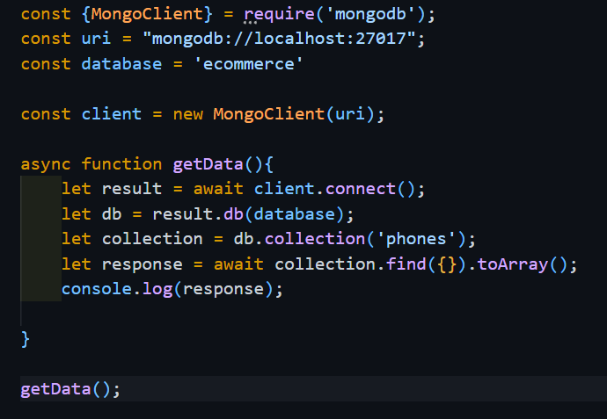
6. Output Screenshot Example
NodeJS MongoDB Connection Code (Example)
MongoDB connection code in NodeJS

Slide 40
7. Advantages of NodeJS MongoDB Connection
Fast and scalable backend development
JSON-based data structure compatibility
Asynchronous and non-blocking operations
Easy integration with REST APIs
Suitable for modern web applications

Slide 41
Adding and retrieving data to MongoDB from NodeJS

Slide 42
1. Introduction
Node.js is a server-side JavaScript runtime used to build backend applications.
MongoDB is a NoSQL database that stores data in JSON-like documents.
Connecting NodeJS with MongoDB allows developers to store, read, update, and delete data from the database. The connection is typically done using the MongoDB Node.js Driver.

Slide 43
2. Prerequisites
Before adding and retrieving data, the following must be installed:
Node.js
MongoDB database server
MongoDB NodeJS driver
Install the MongoDB package using npm:
npm install mongodb

Slide 44
3. Step 1 – Create a NodeJS Project
Create a project folder and initialize NodeJS.
mkdir node-mongodb-app
cd node-mongodb-app
npm init –y
Install MongoDB driver:
npm install mongodb

Slide 45
4. Step 2 – Import MongoDB Module
Create a file named app.js and import the MongoDB driver.
const { MongoClient } = require("mongodb");
This imports the MongoClient class used to connect NodeJS with MongoDB.

Slide 46
5. Step 3 – Create MongoDB Connection
Define the MongoDB connection URL.
const url = "mongodb://127.0.0.1:27017";
const client = new MongoClient(url);
Component | Meaning
mongodb:// | MongoDB protocol
127.0.0.1 | Localhost
27017 | Default MongoDB port

Slide 47
6. Step 4 – Connect to MongoDB
Use an asynchronous function to connect to the database.
async function connectDB() {
await client.connect();
console.log("Connected to MongoDB");
}
connectDB();
Output in terminal:
Connected to MongoDB

Slide 48
7. Step 5 – Select Database and Collection
After connecting, select a database and collection.
const db = client.db("mydatabase");
const collection = db.collection("students");
mydatabase → database
namestudents → collection name

Slide 49
8. Step 6 – Insert Data into MongoDB
Use insertOne() to add a document.
async function insertData() {
await client.connect();
const db = client.db("mydatabase");
const collection = db.collection("students");
const result = await collection.insertOne({
name: "Rahul",
age: 21,
course: "BCA"
});
console.log("Data Inserted:", result);
}
insertData();
Example document stored in MongoDB:
{ name: "Rahul",
age: 21,
course: "BCA"}

Slide 50
9. Step 7 – Retrieve Data from MongoDB
Use find() to retrieve documents.
async function getData() {
await client.connect();
const db = client.db("mydatabase");
const collection = db.collection("students");
const data = await collection.find({}).toArray();
console.log("Students Data:", data);
}
getData();
Method | Purpose
find() | Retrieves documents
toArray() | Converts result to array

Slide 51
10. Complete Example Program
const { MongoClient } = require("mongodb");
const url = "mongodb://127.0.0.1:27017";
const client = new MongoClient(url);
async function main() {
await client.connect();
const db = client.db("mydatabase");
const collection = db.collection("students");
// Insert Data
await collection.insertOne({
name: "Amit",
age: 22,
course: "BCA"
});
// Retrieve Data
const students = await collection.find({}).toArray();
console.log(students);}
main();
Output :
Terminal output:
Connected to MongoDB[ { name: 'Amit', age: 22, course: 'BCA' }]

Slide 52
Handling SQL databases from NodeJS

Slide 53
1. Introduction
Node.js is a JavaScript runtime used to build server-side applications. An SQL database stores data in structured tables using Structured Query Language (SQL).
Common SQL databases used with NodeJS include:
MySQL
PostgreSQL
SQLite
Microsoft SQL Server
NodeJS interacts with SQL databases using database drivers or libraries that allow executing SQL queries from JavaScript.

Slide 54
2. Steps to Handle SQL Database in NodeJS
Step 1 – Install Database Package
To work with MySQL, install the MySQL package.
npm install mysql
This package allows NodeJS to connect and communicate with the MySQL database server.
Step 2 – Import MySQL Module
Create a NodeJS file (example: app.js) and import the module.
const mysql = require('mysql');
This loads the MySQL driver into the application.

Slide 55
Step 3 – Create Database Connection
Create a connection object with database details.
const connection = mysql.createConnection({
host: "localhost",
user: "root",
password: "",
database: "studentdb"
});
Parameter | Description
host | Database server location
user | Database username
password | Database password
database | Database name

Slide 56
Step 4 – Connect to Database
Establish the connection.
connection.connect(function(err) {
if (err) throw err;
console.log("Connected to MySQL Database");
});
Output:
Connected to MySQL Database
Step 5 – Insert Data into SQL Database
Use SQL INSERT query to add data.
const sql = "INSERT INTO students (name, age, course) VALUES ('Rahul', 21, 'BCA')";
connection.query(sql, function(err, result) {
if (err) throw err;
console.log("Data inserted successfully");
});
This inserts a new record into the students table.

Slide 57
Step 6 – Retrieve Data from SQL Database
Use SQL SELECT query to fetch data.
connection.query("SELECT * FROM students", function(err, result) {
if (err) throw err;
console.log(result);
});
Example Output:
[
{ id: 1, name: 'Rahul', age: 21, course: 'BCA' }
]
Step 7 – Update Data
Use SQL UPDATE query.
const sql = "UPDATE students SET age = 22 WHERE name = 'Rahul'";
connection.query(sql, function(err, result) {
if (err) throw err;
console.log("Record updated");
});

Slide 58
Step 8 – Delete Data
Use SQL DELETE query.
const sql = "DELETE FROM students WHERE name = 'Rahul'";
connection.query(sql, function(err, result) {
if (err) throw err;
console.log("Record deleted");
});

Slide 59
Handling Cookies in NodeJS

Slide 60
1. Introduction
Node.js is used to build server-side web applications. A cookie is a small piece of data stored in the user’s browser and sent back to the server with every request.
Cookies are commonly used for:
User authentication
Session management
Saving user preferences
Tracking user activity
In NodeJS applications (especially with Express.js), cookies are usually handled using the cookie-parser middleware.

Slide 61
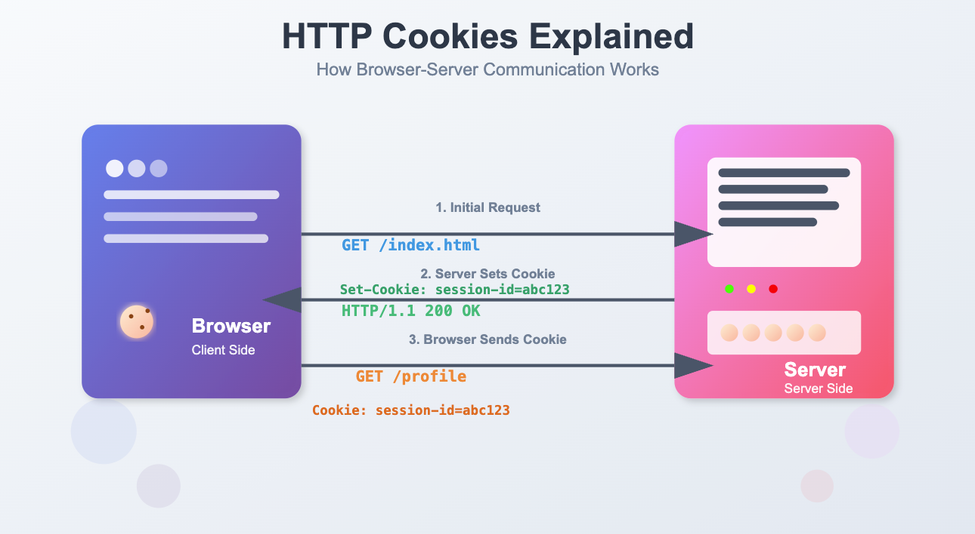
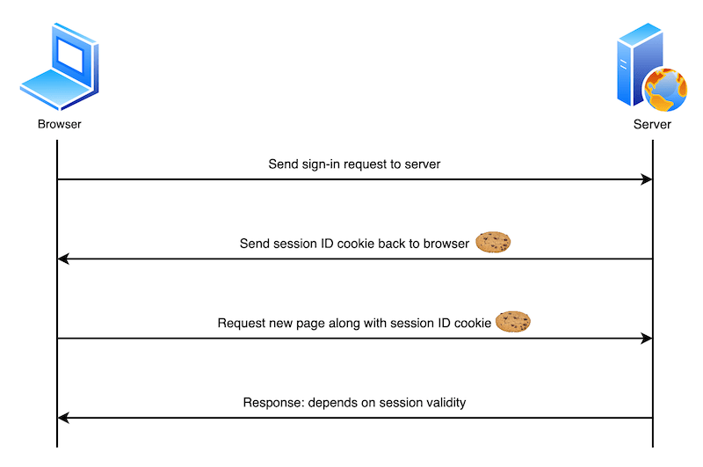
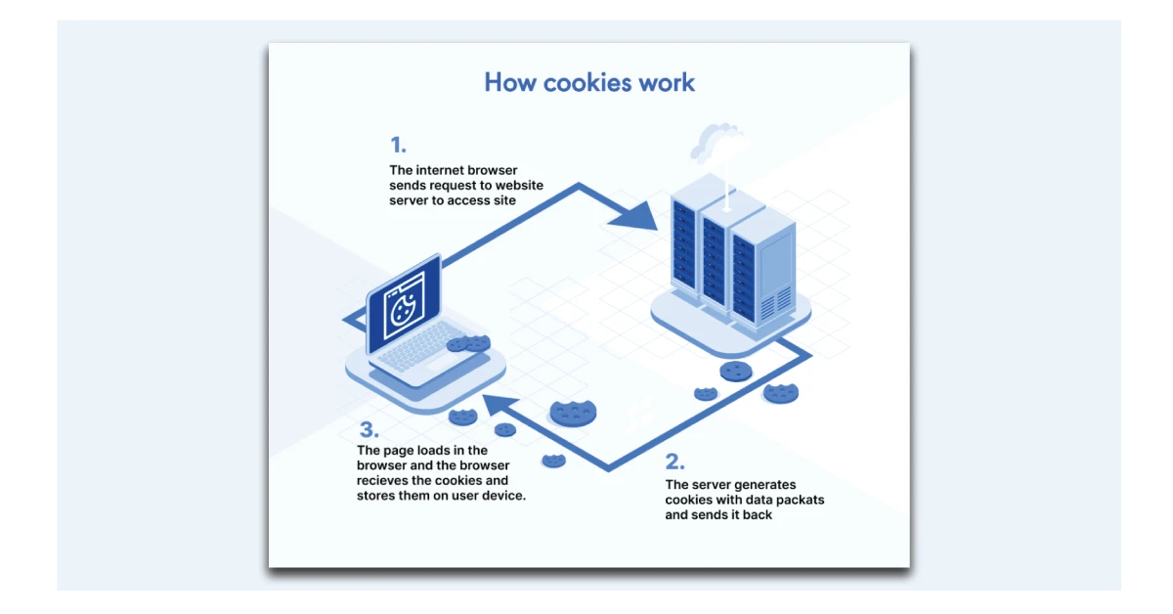
2. Diagram – How Cookies Work

Slide 62
Explanation of Diagram
The client (browser) sends a request to the server.
The server processes the request and sends a response with a cookie using the Set-Cookie header.
The browser stores the cookie locally.
On the next request, the browser automatically sends the cookie back to the server.
The server reads the cookie to identify the user or session.

Slide 63
3. Installing Required Package
To handle cookies in NodeJS, install the cookie-parser package.
npm install cookie-parser
4. Basic Steps to Handle Cookies
Step 1 – Import Required Modules
const express = require('express');
const cookieParser = require('cookie-parser');
Step 2 – Initialize Express App
const app = express();
app.use(cookieParser());
cookieParser() middleware reads cookies from requests and makes them available in req.cookies.
Step 3 – Setting a Cookie
app.get('/set-cookie', (req, res) => {
res.cookie("username", "John", { maxAge: 900000, httpOnly: true });
res.send("Cookie has been set");
});
The server sends a Set-Cookie header, which instructs the browser to store the cookie.

Slide 64
Step 4 – Reading Cookies
app.get('/get-cookie', (req, res) => {
res.send(req.cookies);
});
req.cookies contains cookies sent by the browser.
Step 5 – Deleting Cookies
app.get('/delete-cookie', (req, res) => {
res.clearCookie("username");
res.send("Cookie deleted");
});

Slide 65
5. Example Complete Program
const express = require('express');
const cookieParser = require('cookie-parser');
const app = express();
app.use(cookieParser());
// Set cookie
app.get('/set', (req, res) => {
res.cookie("user", "Rahul");
res.send("Cookie Set");
});
// Read cookie
app.get('/read', (req, res) => {
res.send(req.cookies);
});
// Delete cookie
app.get('/delete', (req, res) => {
res.clearCookie("user");
res.send("Cookie Deleted");
});
app.listen(3000, () => {
console.log("Server running on port 3000");
});

Slide 66
Handling User Authentication with NodeJS.

Slide 67
1. Introduction
Node.js is commonly used to build backend web applications.
User authentication is the process of verifying the identity of a user before allowing access to a system or protected resources.
Authentication ensures that only authorized users can access certain parts of an application such as dashboards, user accounts, or admin pages.

Slide 68
2. Authentication vs Authorization
Example:
Logging in with username/password → Authentication
Accessing admin panel → Authorization
Concept | Meaning
Authentication | Verifies who the user is (login process)
Authorization | Determines what the user can access after login

Slide 69
3. Common Authentication Methods in NodeJS
1. JSON Web Token (JWT)
JSON Web Token is widely used for stateless authentication in APIs.
How it works:
User sends login credentials.
Server verifies the credentials.
Server generates a JWT token.
Token is sent to the client.
Client sends the token with future requests.
Server verifies the token before granting access.

Slide 70
3. Common Authentication Methods in NodeJS
2. Session-Based Authentication
In this method:
User logs in.
Server creates a session.
A session ID is stored in a cookie.
Each request includes the cookie.
Server checks session data.

Slide 71
3. Common Authentication Methods in NodeJS
3. Third-Party Authentication
Developers can also use external services such as:
Passport.js
Auth0
OAuth 2.0
These simplify login systems like Login with Google or GitHub.

Slide 72
4. Security Best
Hash passwords using bcrypt
Never store passwords in plain text
Use HTTPS for secure communication
Store secret keys in environment variables using dotenv

Slide 73
5. Steps to Implement Authentication using JWT
Step 1 – Install Required Packages
npm install express bcryptjs jsonwebtoken dotenv
Packages used:
Package | Purpose
express | Web framework
bcryptjs | Password hashing
jsonwebtoken | Generate authentication tokens
dotenv | Manage environment variables

Slide 74
6. Example – User Registration
const express = require("express");
const bcrypt = require("bcryptjs");
const app = express();
app.use(express.json());
let users = [];
app.post("/register", async (req, res) => {
const { username, password } = req.body;
const hashedPassword = await bcrypt.hash(password, 10);
users.push({
username: username,
password: hashedPassword
});
res.send("User registered successfully");
});
app.listen(3000);
Explanation:
Password is hashed using bcrypt
Hashed password is stored instead of plain text

Slide 75
7. Example – User Login
const jwt = require("jsonwebtoken");
app.post("/login", async (req, res) => {
const { username, password } = req.body;
const user = users.find(u => u.username === username);
if (!user) {
return res.send("User not found");
}
const validPassword = await bcrypt.compare(password, user.password);
if (!validPassword) {
return res.send("Invalid password");
}
const token = jwt.sign(
{ username: user.username },
"SECRET_KEY",
{ expiresIn: "1h" }
);
res.json({ token });
});
Explanation:
User credentials are verified
If valid, a JWT token is generated
Token is sent to the client

Slide 76
8. Protecting Routes with Middleware
function authenticateToken(req, res, next) {
const token = req.headers["authorization"];
if (!token) return res.send("Access denied");
jwt.verify(token, "SECRET_KEY", (err, user) => {
if (err) return res.send("Invalid token");
req.user = user;
next();
});
}
app.get("/dashboard", authenticateToken, (req, res) => {
res.send("Welcome to protected dashboard");
});
Explanation:
Middleware verifies the JWT token
Only valid users can access protected routes

Slide 77
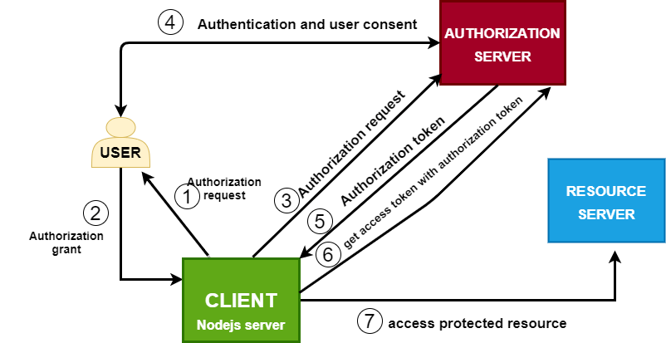
9. Authentication Flow Diagram

Slide 78
THANK YOU

